Slide 1
MNIST-Digit-Recognition
Using CNN

Slide 2
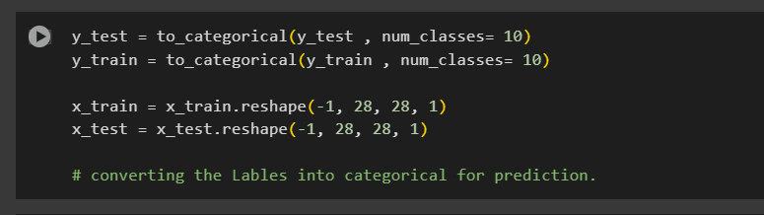
Code walkthrough
Import MNIST dataset for training
Import necessary keras libraries for Number prediction and model training
Convert the target variables to categorical , used to last layer for CNN for prediction.
Reshape the train_x and test_x data and scale the input before passing to the model

Slide 3
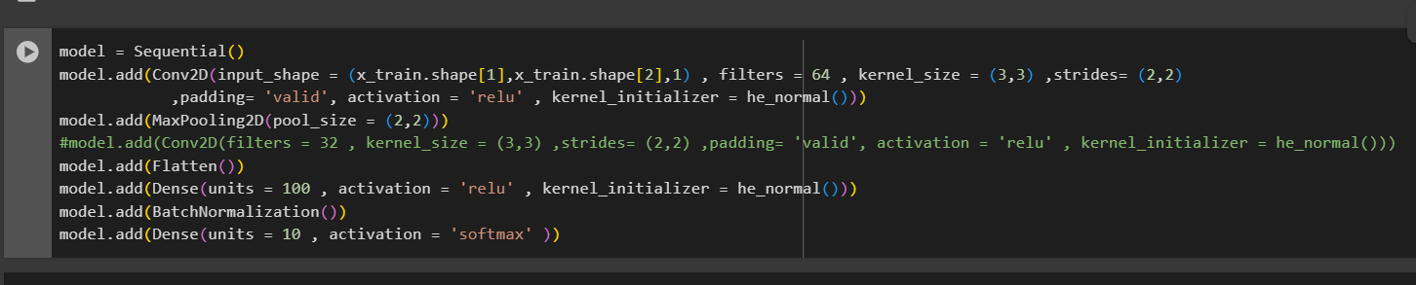
After preprocessing , then start building the model.
Here we use sequential and start with Convolution 2d and hyper-parmeters as mentioned bellow.
Aslo we using maxpooling and batchnormalisation within the hidde layer for max performance.

Slide 4
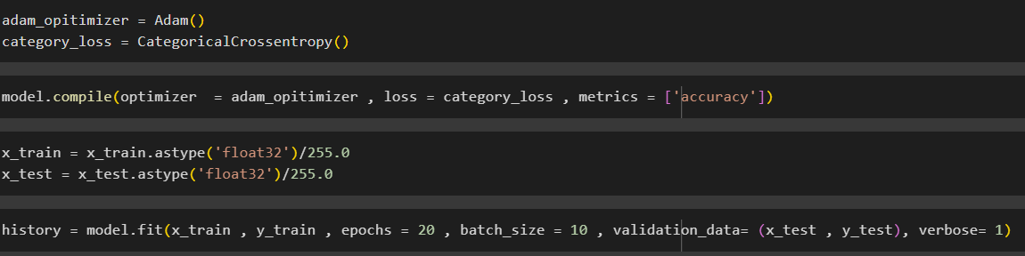
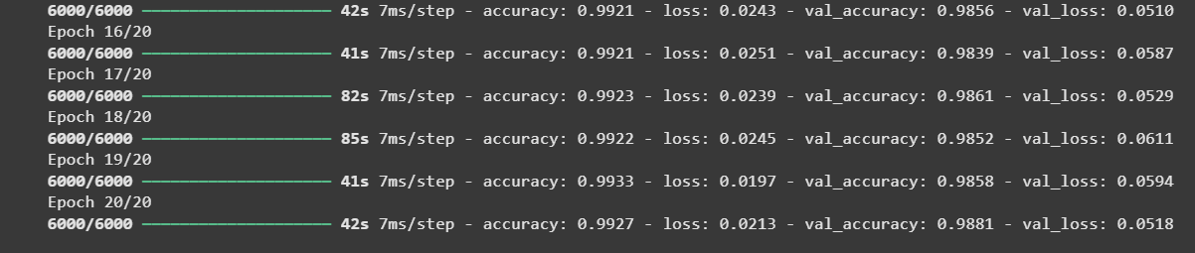
After building model , the model is compiled and fitted.
For this model i have set 20 Epoch with batch size of 10

Slide 5
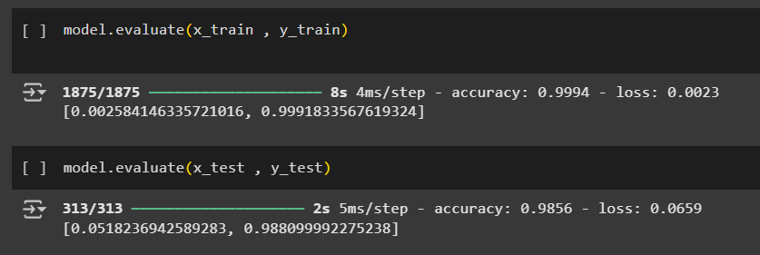
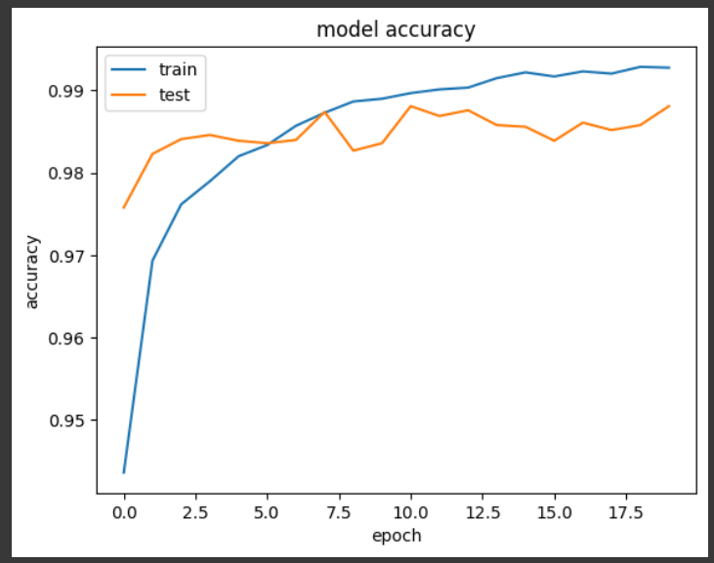
Model accuracy:

Slide 6
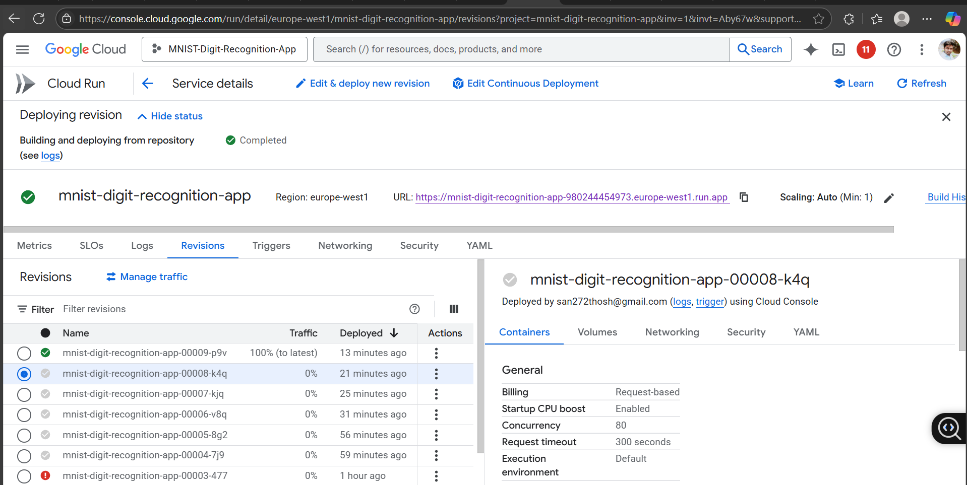
GCP Cloud Deployement:
https://mnist-digit-recognition-app-980244454973.europe-west1.run.app

Slide 7
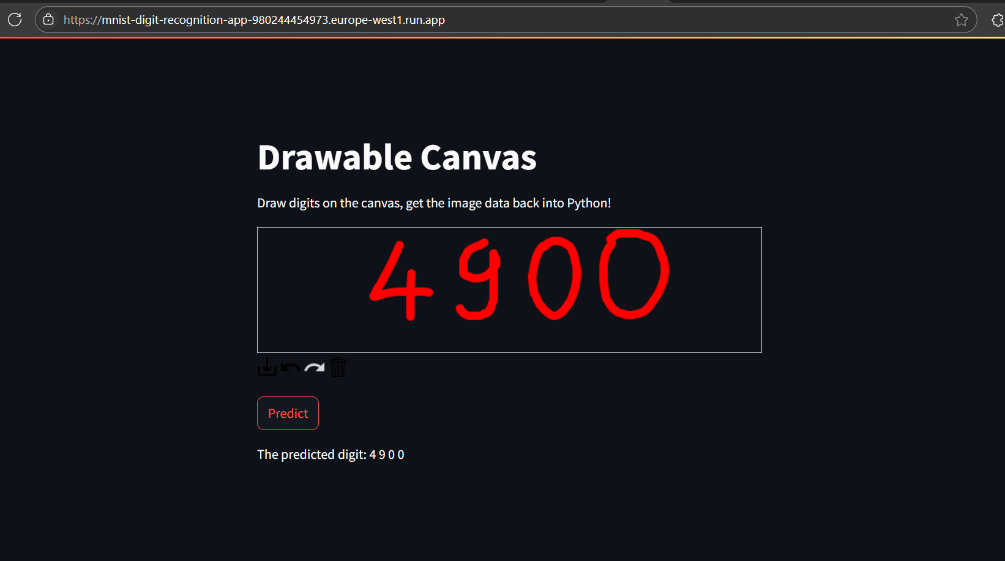
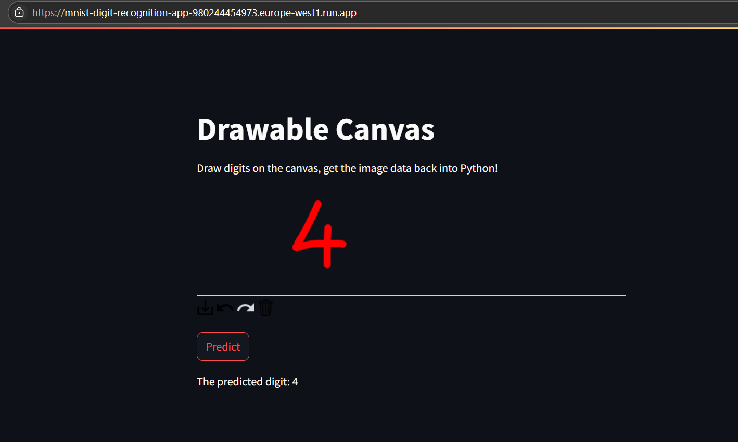
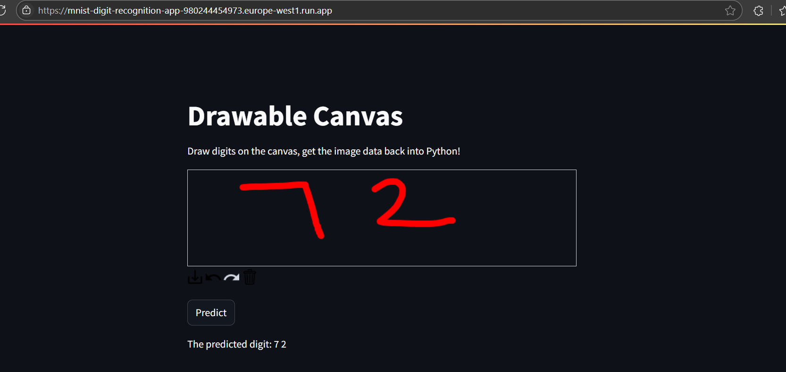
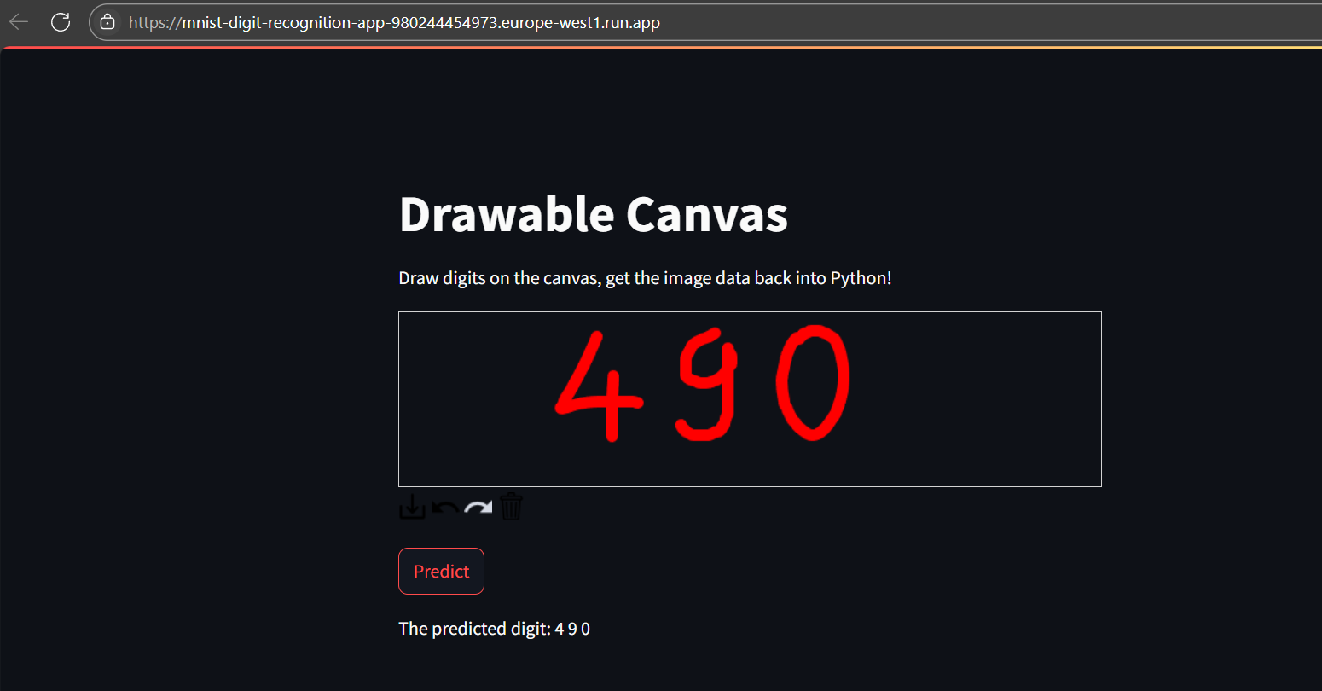
Predicted results:

Slide 8
Thanks You !!

